Slide 1




Slide 2
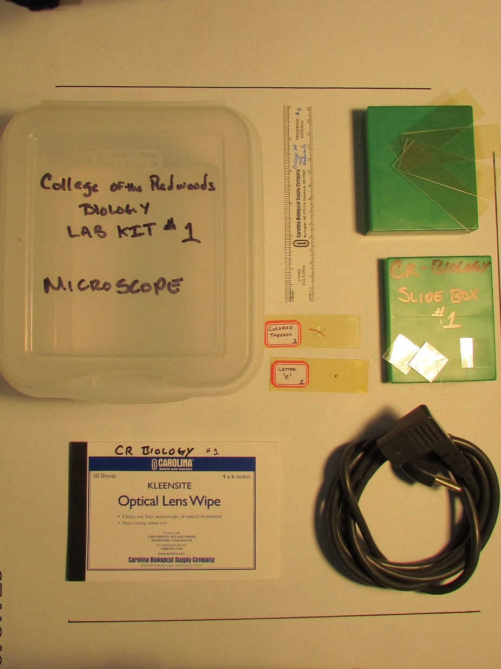
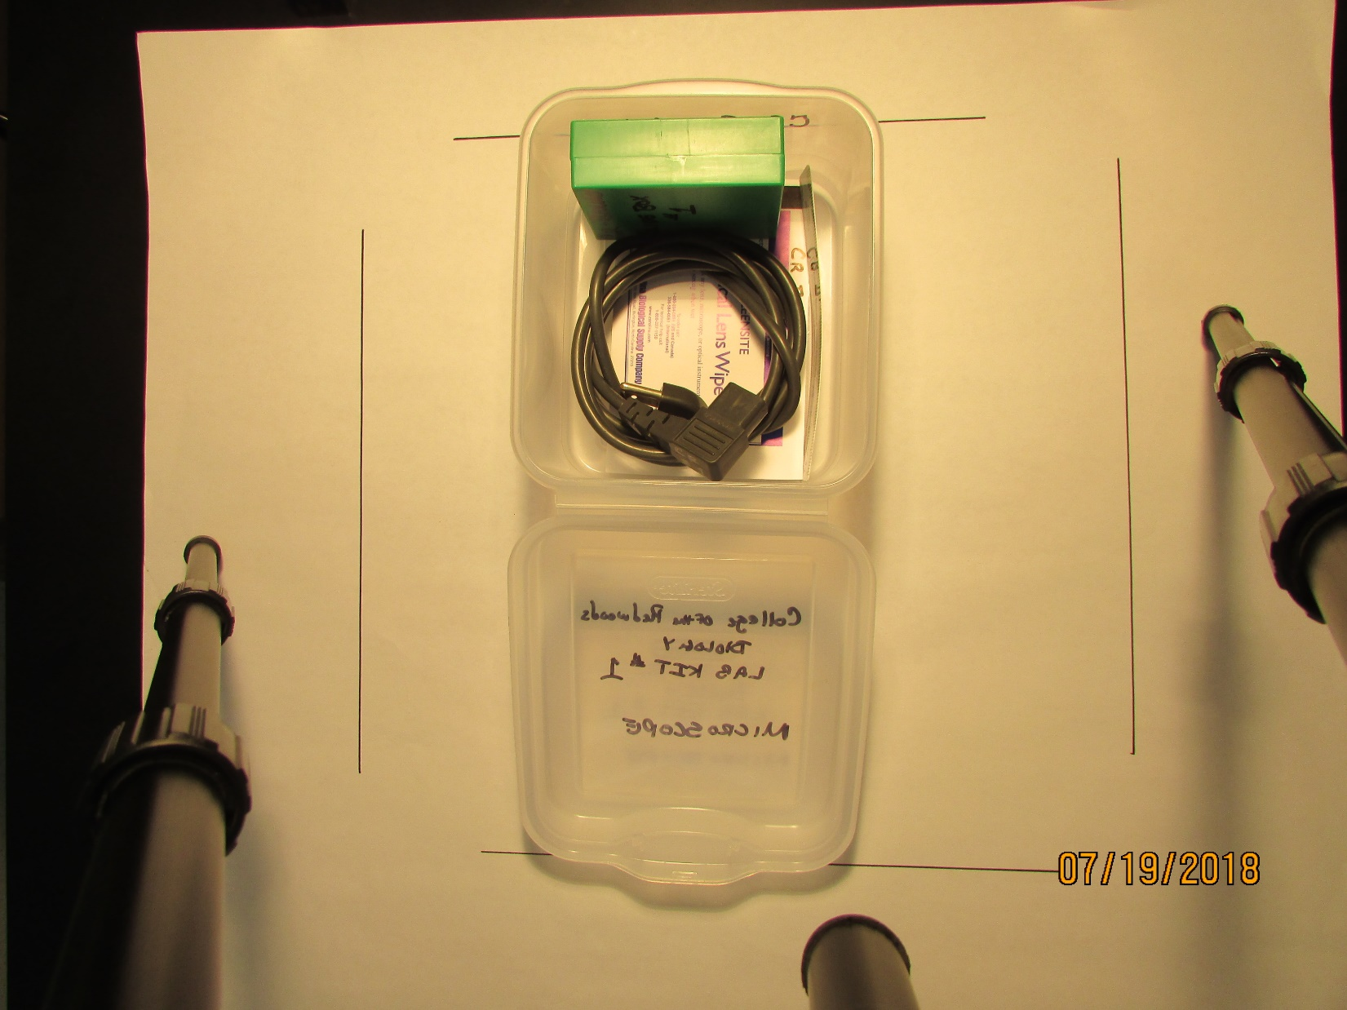
College of the Redwoods
Biology
4
1
5
7
6
8
3
2
MICROSCOPE LAB KIT
INVENTORY
1 plastic ruler
1 book of optical lens paper
1 AC power cord
1 slide box
4 blank plastic microscope slides
4 plastic slide cover slips
1 prepared slide (colored threads)
1 prepared slide (letter ‘e’)

Slide 3
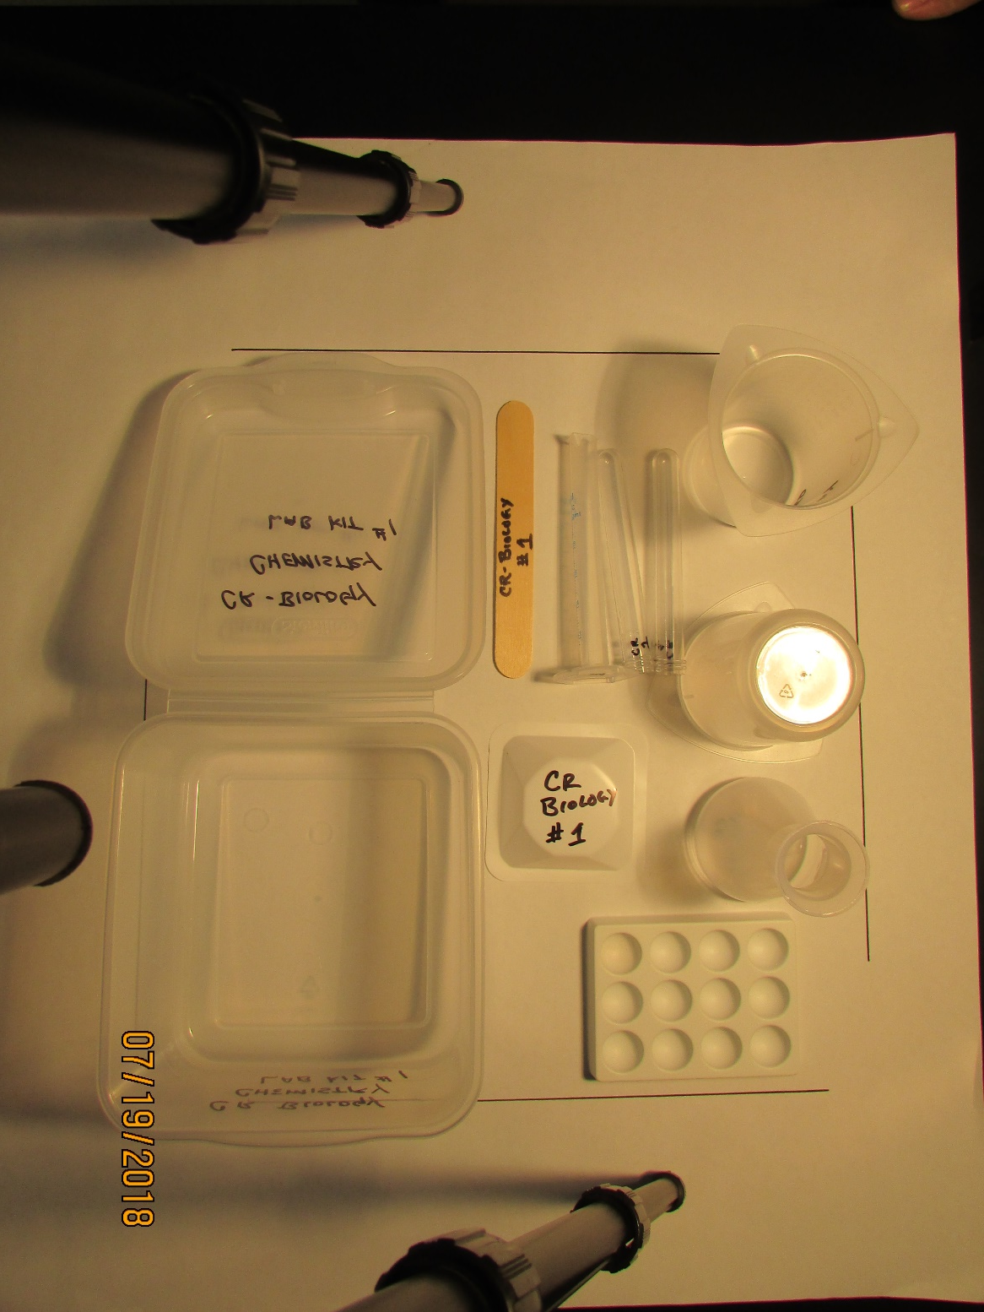
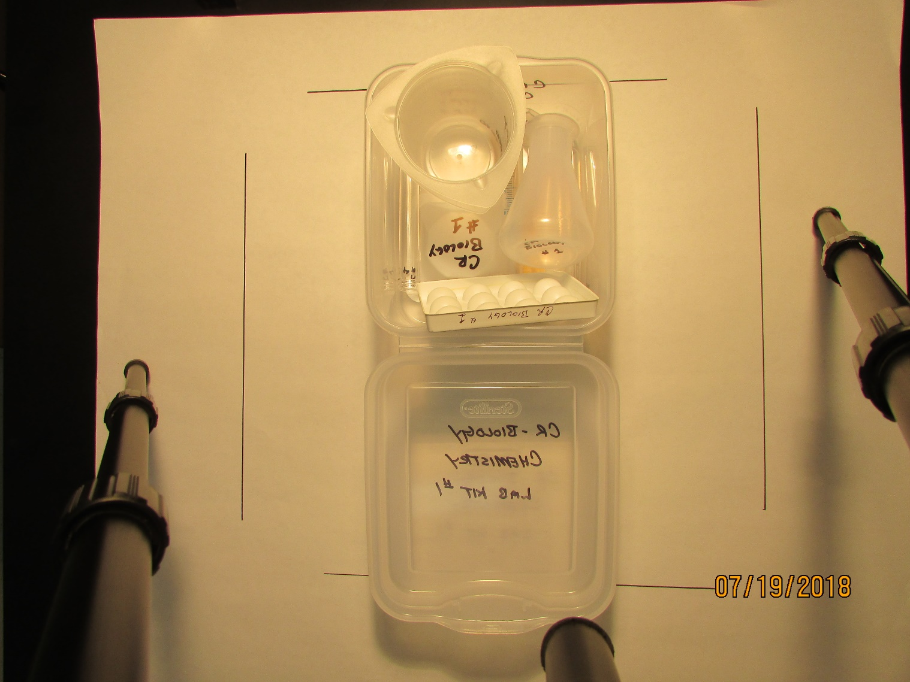
College of the Redwoods
Biology
1
3
4
2
6
5
7
CHEMISTRY LAB KIT
INVENTORY
1 wooden tongue depressor
1 plastic graduated cylinder (10 ml)
2 plastic test tubes
2 plastic tri-pour beakers (250 ml)
1 plastic Erlenmeyer flask (100 ml)
1 medium plastic weigh boat
1 plastic spot plate

Slide 4
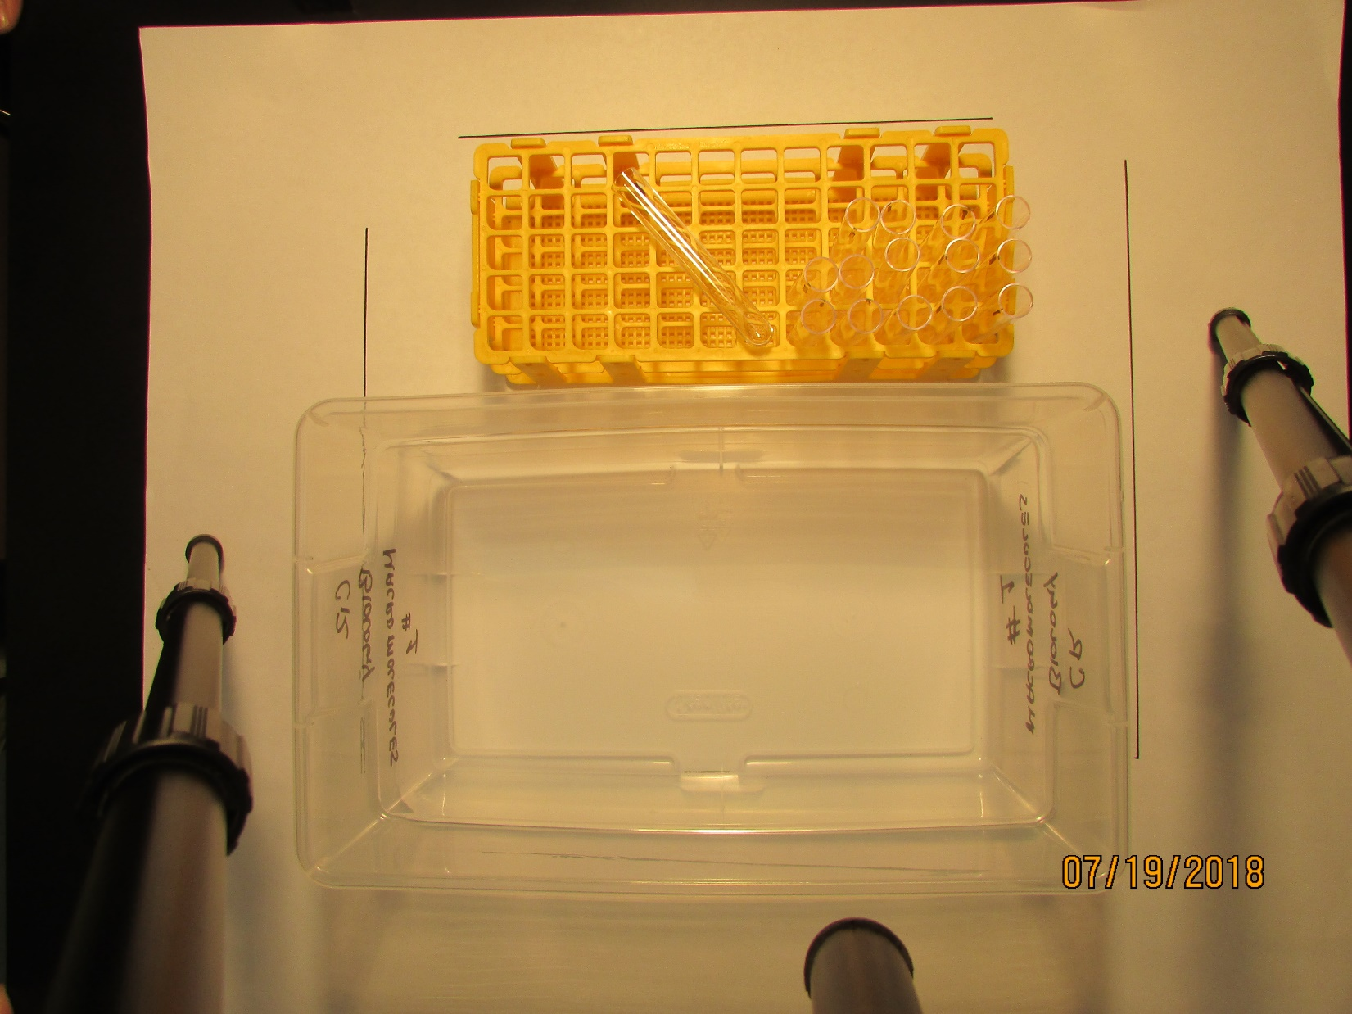
College of the Redwoods
Biology
1
2
MACROMOLECULE LAB KIT
INVENTORY
1 test tube rack
15 plastic test tubes

Slide 5
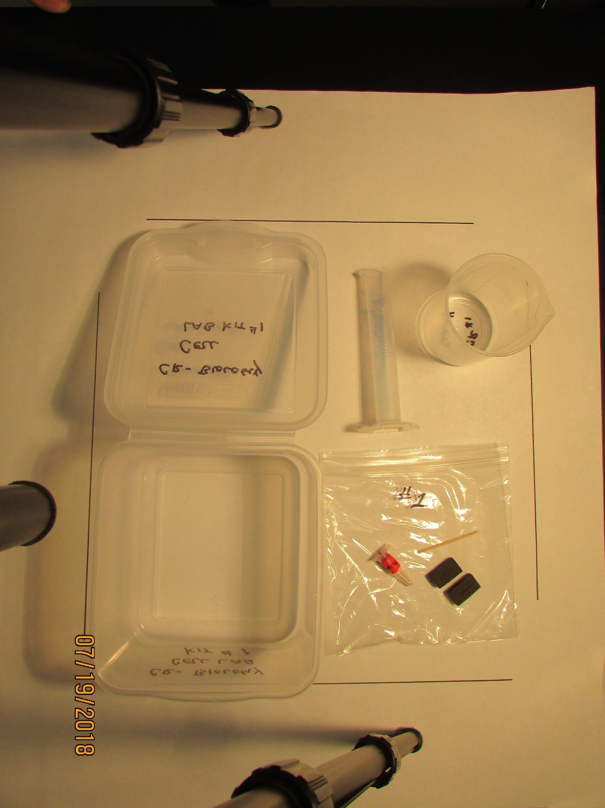
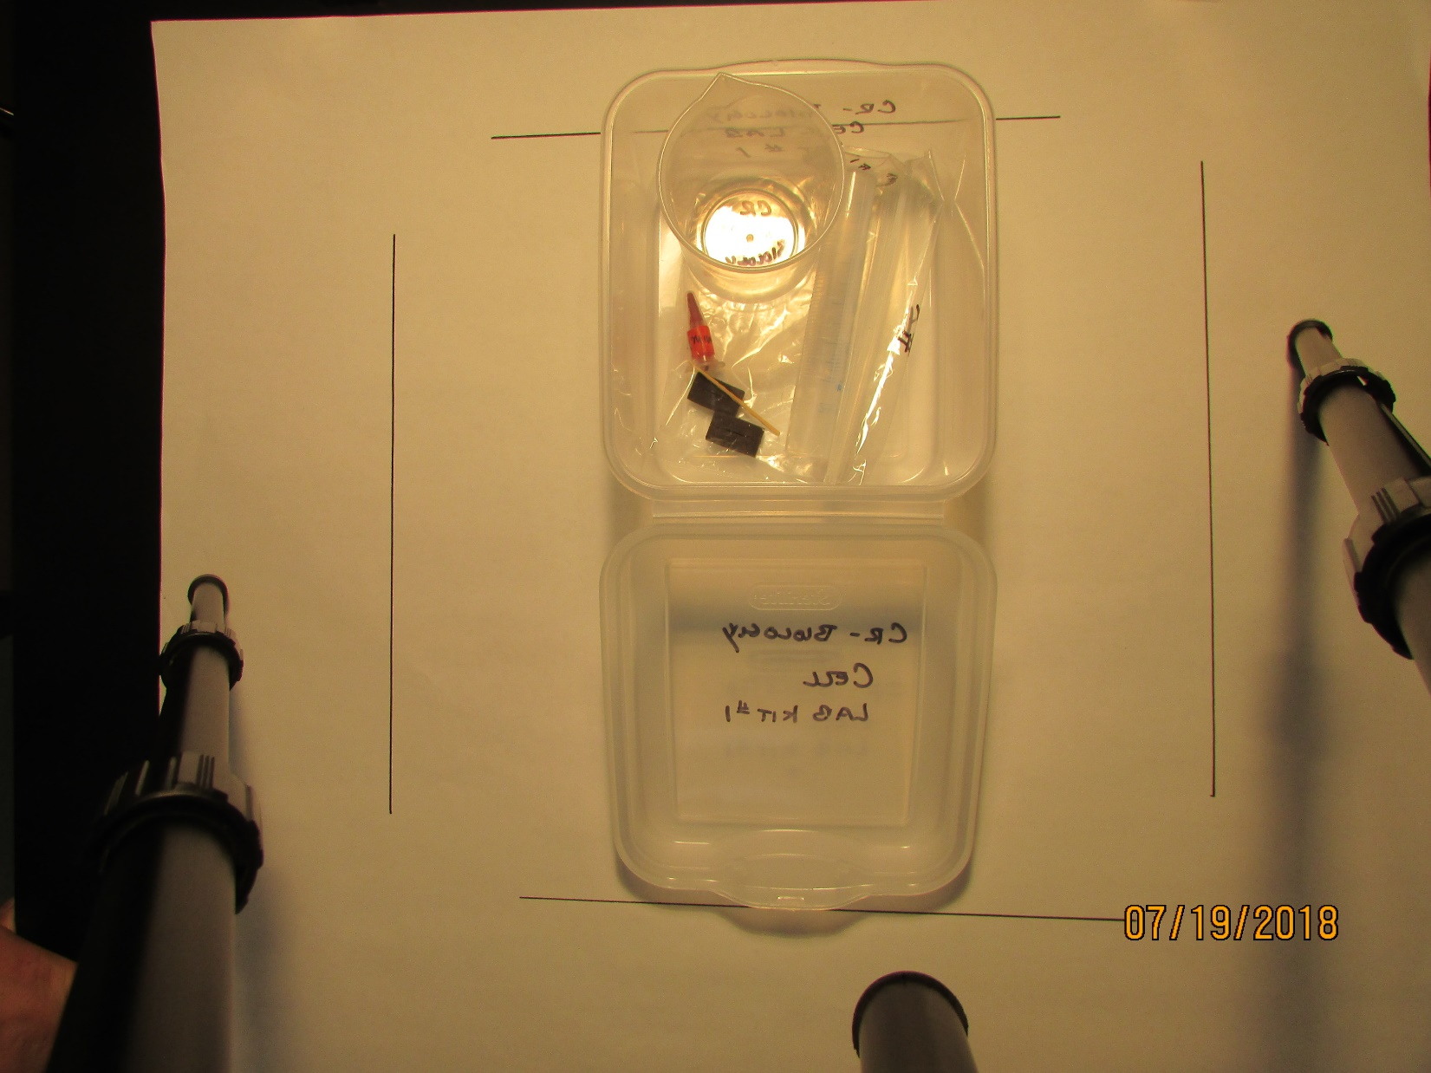
College of the Redwoods
Biology
1
2
1
2
3
4
5
6
CELL LAB KIT
INVENTORY
1 plastic graduated cylinder (25 ml)
1 plastic beaker (300 ml)
1 small zip-lock bag
1 flat wooden tooth pick
1 small plastic tube of carmine red powder
2 foam stoppers

Slide 6
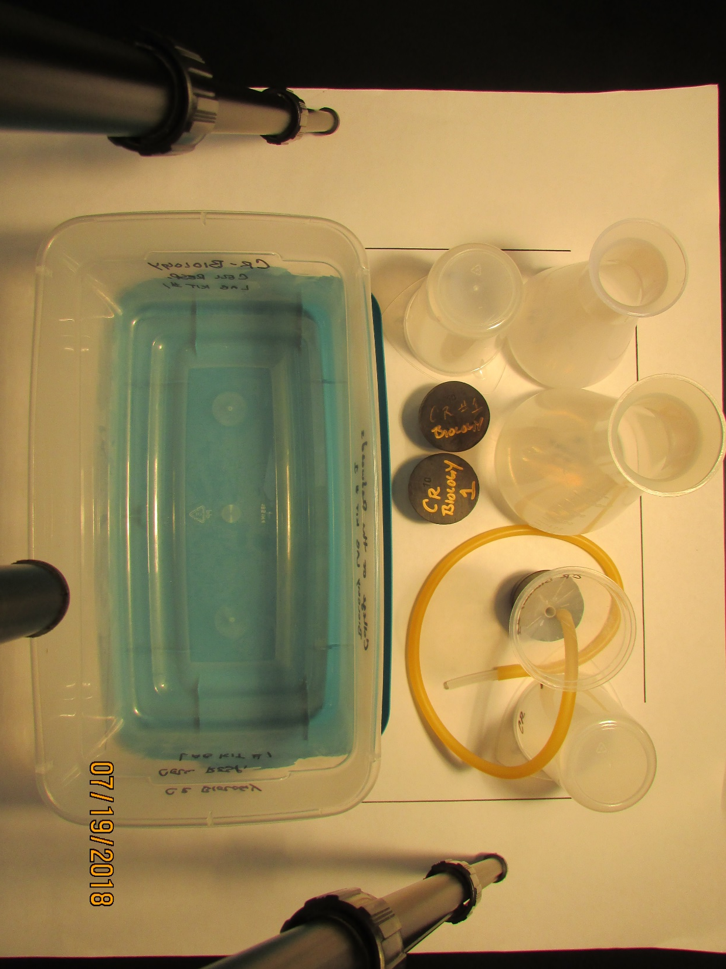
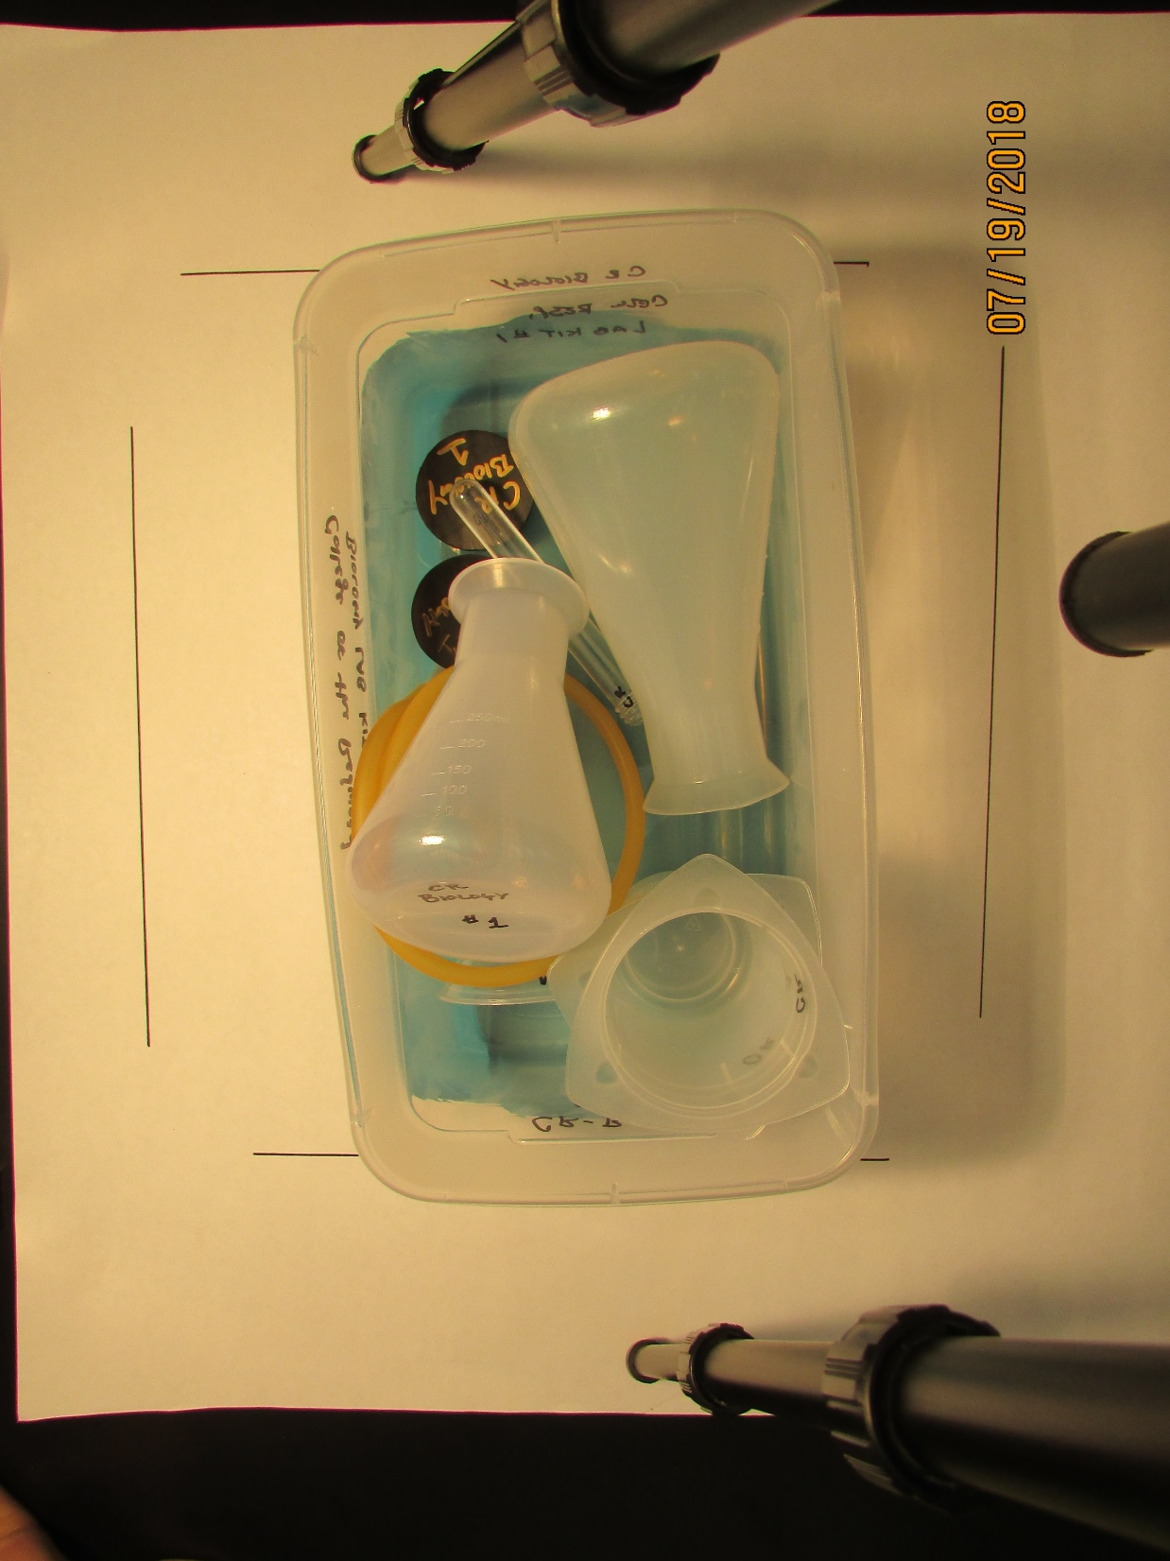
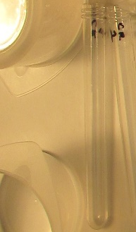
College of the Redwoods
Biology
1
1
2
2
3
5
4
1
CELL RESPIRATION LAB KIT
INVENTORY
2 plastic tri-pour beakers (250 ml)
2 plastic Erlenmeyer flasks (500 ml)
2 rubber stoppers #10
1 gas funnel apparatus (5 pieces total; rubber stopper, plastic funnel, surgical tube, 2 plastic inserts)
1 plastic test tube

Slide 7
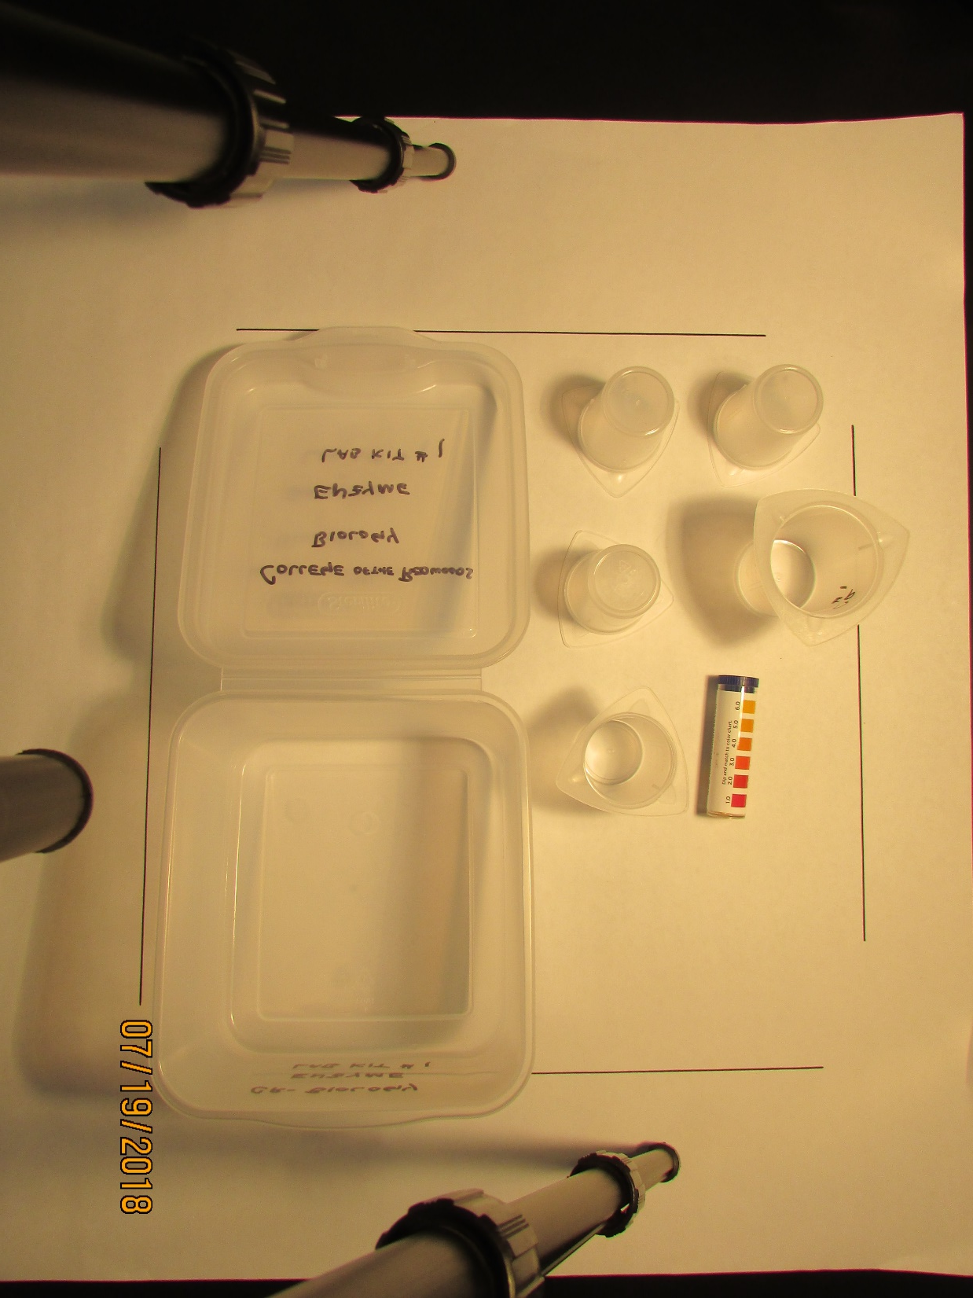
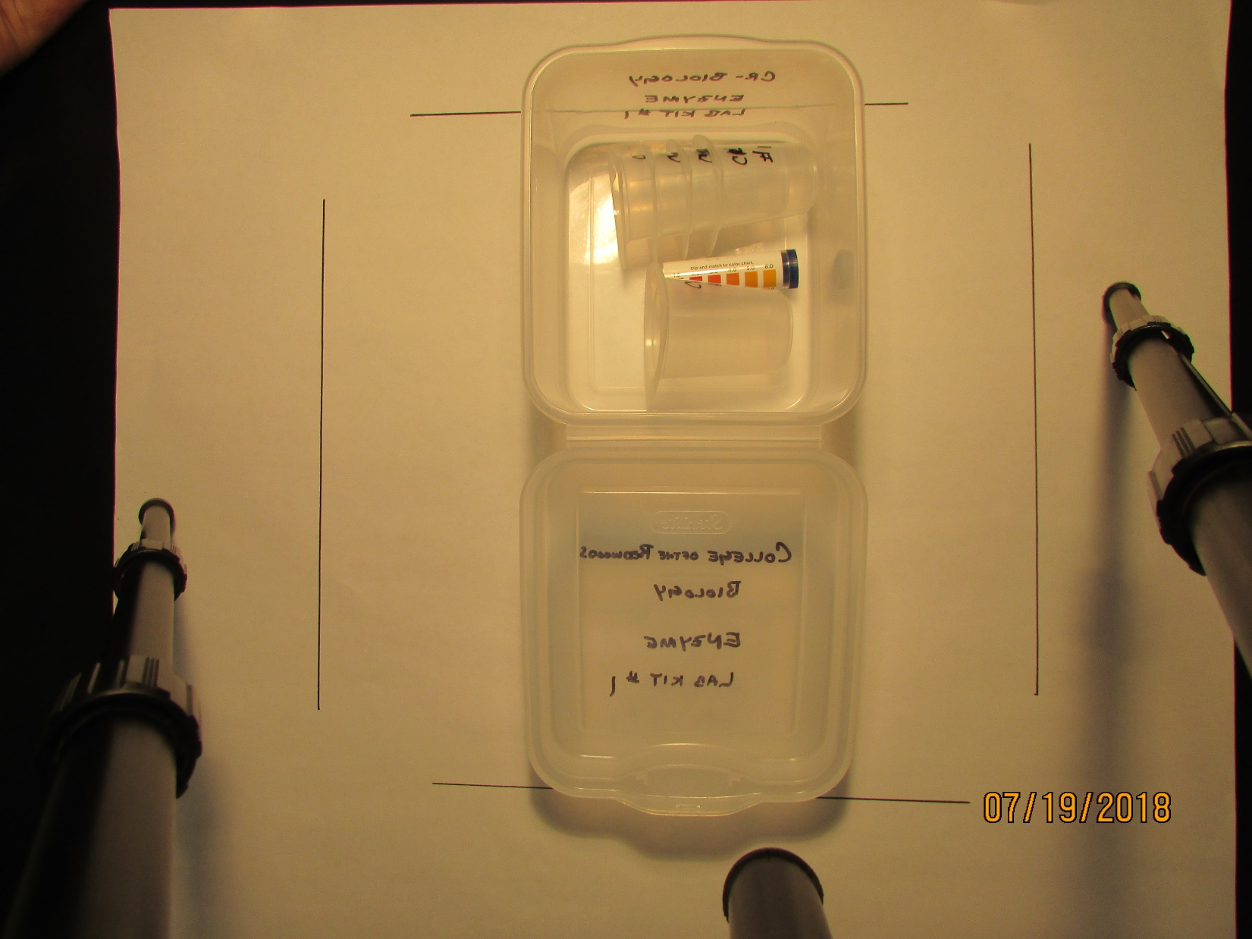
College of the Redwoods
Biology
1
2
1
2
3
ENZYME LAB KIT
INVENTORY
4 plastic tri-pour beakers (50 ml)
1 tri-pour beaker (100 ml)
1 tube pH test paper (Hydrion)

Slide 8
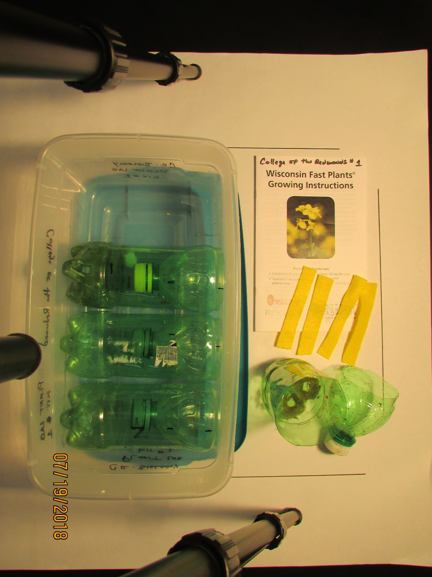
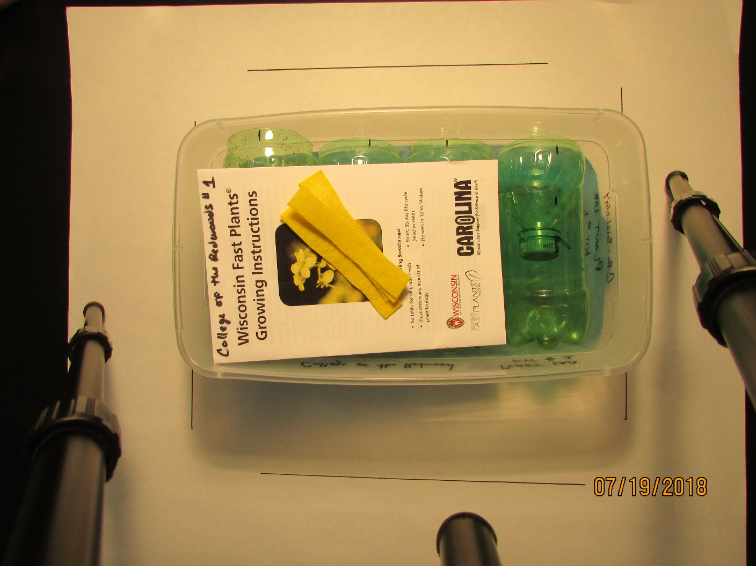
College of the Redwoods
Biology
2
1
2
3
PLANT LAB KIT
INVENTORY
1 Fast Plant instruction book
4 felt wicks
4 soda bottles cut in half (20 oz)

Slide 9
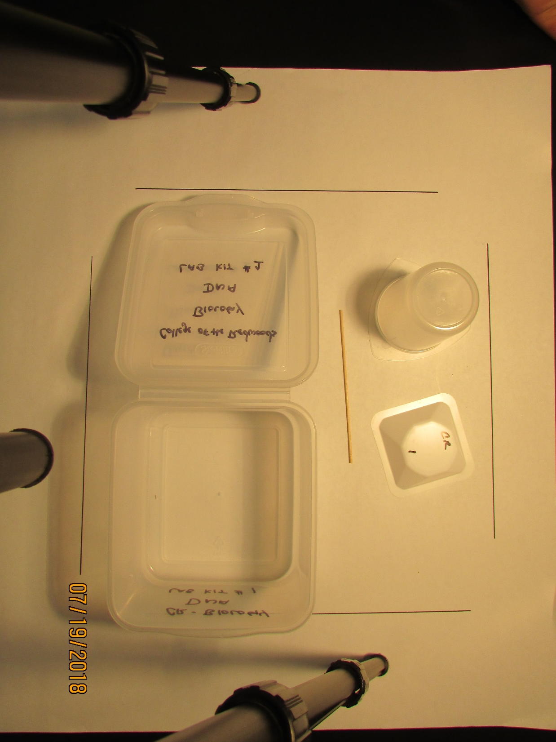
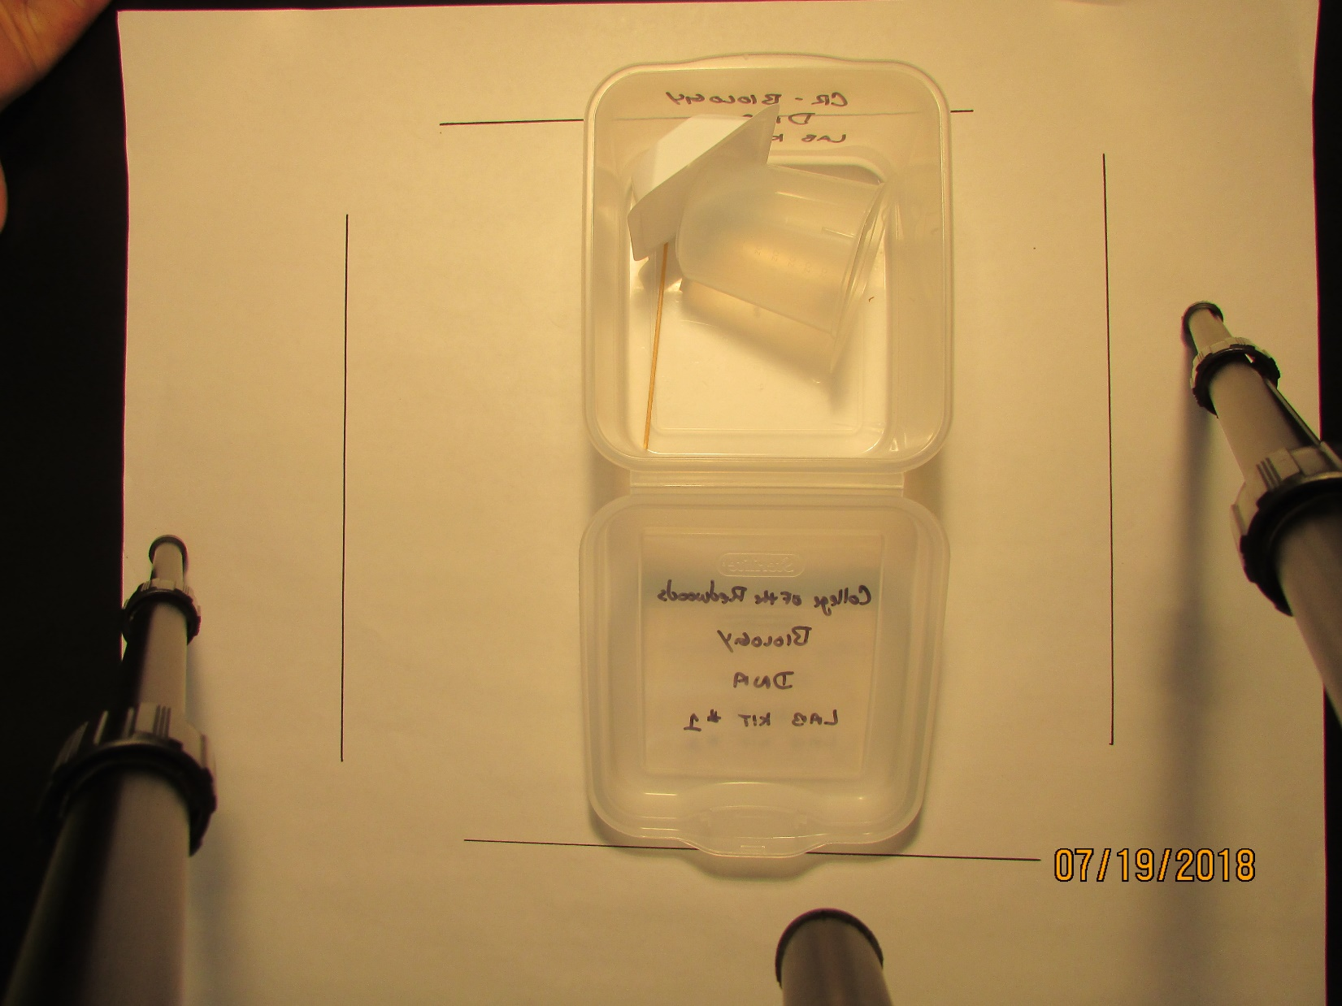
College of the Redwoods
Biology
1
2
2
3
DNA LAB KIT
INVENTORY
1plastic tri-pour beaker (250 ml)
1 wooden stint
1 medium plastic weigh boat

